Slide 1
Budget Sales Analysis

Slide 2
Steps Followed:
Data Collection
Importing Libraries
Loading Data
Missing Value Imputation
Data Cleaning
Insights
EDA
Modeling
Power Bi desktop
Reporting

Slide 3
Details of project
Project Title | Budget Sales Analysis
Technologies | Data Science /Data Analyitics
Domain | Retail and Sales
Project Difficulty Level | Advanced
Programming Language Used | Python
Tools used | Jupyter Notebook, Power Bi

Slide 4
Objective:
This project is to analysis the Customer data, Product data, Sales data and Budget Data of a Retail chain and extract keys insights that can be valuable in taking business decisions

Slide 5
Problem Statement:
Our "Domain Sale" process is structured to help potential buyers purchase the domain they want immediately without the hassle of contacting the seller directly. ... A seller lists a domain for sale at a specific price in our Marketplace. An interested buyer sees this domain for sale and decides to buy it. Extract various information such as Sales, budget, and variance. You can even compare sales and budgets with various attributes. Extract necessary information about Products and Customers. Make the necessary dashboard with the best you can extract from the data. Use various visualization and features and make the best dashboard. Find key metrics and factors and show the meaningful relationships between attributes. Do your own research and come up with your findings

Slide 6
Power BI DashBoard
Next

Slide 7
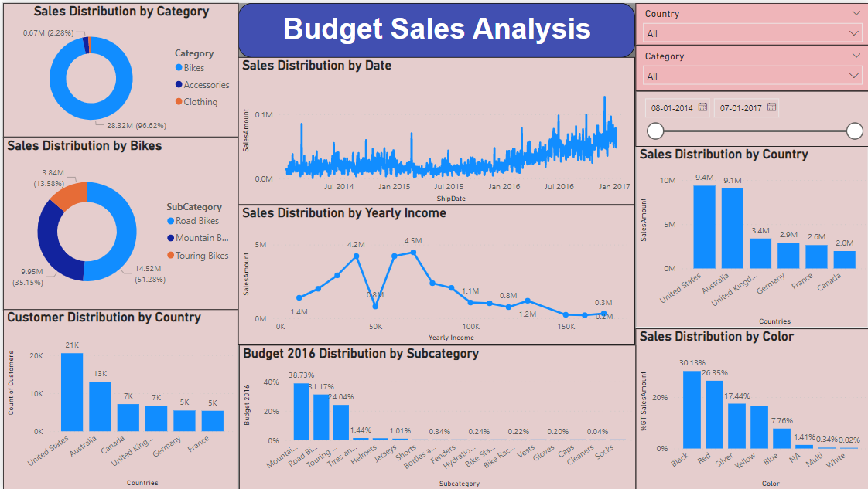


Slide 8
Dataset Information:
This dataset contains various tables:
Budget Data: Contains the features of the sales of budget year 2016.
Customer Data: Contains features regarding the customers.
Sales Data: Contains the features regarding the sales of the products.
Territory Data: Contains the features of the territory of the sales.
Product Data: Contains the features of the products sold.

Slide 9
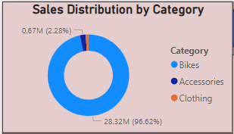
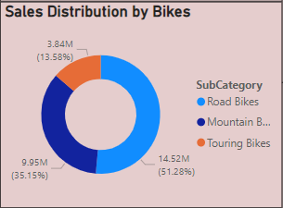
Insights
Sales Data
Bikes has the most sales among all the categories.
Road Bikes are the most sold among the Bikes category.

Slide 10
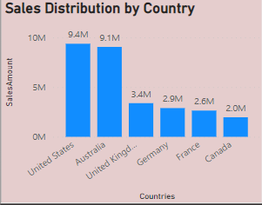
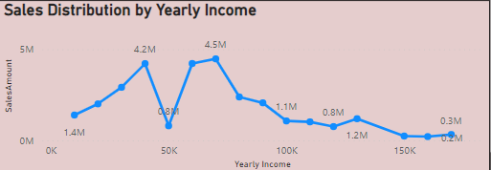
Sales Data
Nearly 65% of the total sales amount comes from U.S and Australia.
Customers with Yearly income between 35K-80K shows a higher contribution to the Sales Amount.

Slide 11
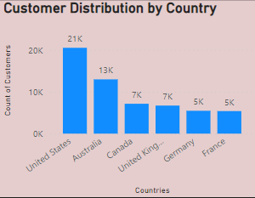
Customer Data
Most of the customers are from U.S and Australia.
It makes more than 65% of the Customer Data.

Slide 12
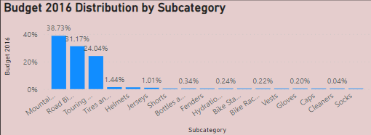
Budget 2016
The Mountain Bikes makes the most sales in the year 2016 followed by Road Bikes and Touring Bikes.
These 3 Subcategories make contributes towards more than 90% of the sales.

Slide 13
KEY PERFORMANCE INDICATOR:
• Distribution of customers and sales with respect to Countries.
• Distribution of sales with respect to the product category.
• Distribution of sales with respect to the product sub-category.
• Distribution of sales with respect to yearly income of the customers.
• Budget distribution with respect to product category and sub-category.

Slide 14
Conclusion:
According to the analysis done I can conclude that:
96.62% of sales comes from the category of product ‘Bikes’, but only 94% of budget goes to ‘Bikes’.
Among the product category ‘bikes’, more than 50% of sales comes from road bikes, but only 33% of the budget goes to the same.
• Nearly 61% of the sales comes from only two countries i.e. United States and Australia.
Gender and Marital status distribution of customers is more or less the same.
Per customer sales of Australia is significantly more than that of United States.
Company has experienced a significant increase in both profit and sales throughout the year 2016.

Slide 15
THANK YOU
Priya Jangid
https://github.com/peajangid
www.linkedin.com/in/priyajangid
priyajangid.data@gmail.com

